Slide 1
Memory Design

Slide 2
RAM CHIPS
Features:
    RAM Chips is suited for the communication with the CPU if it has one or more control inputs that select the chip only when needed
    Bidirectional Databus – that allows the data either from CPU to memory or memory to CPU
    Bidirectional Data Bus can be constructed with three state Buffers
        Logic 0
        Logic 1
        High Impedence state

Slide 3
Memory Block Diagram
A basic memory system is shown here:
k address lines are decoded to address 2^{k} words of memory.
Each word is n bits.
Read and Write are single control lines defining the simplest of memory operations.
n Data Input Lines
n
k Address Lines
Memory
k
Unit
2^{k} Words
1
n Bits per Word
Read
1
Write
n
n Data Output Lines

Slide 4
RAM Chips
Capacity of the Memory is 128 words of eight bits
7 bit Address and 8 –bit bidirectional data bus
Read & Write -Memory operation
Chip Select control Inputs are for enabling the chip only when it is selected by the microprocessor

Slide 5
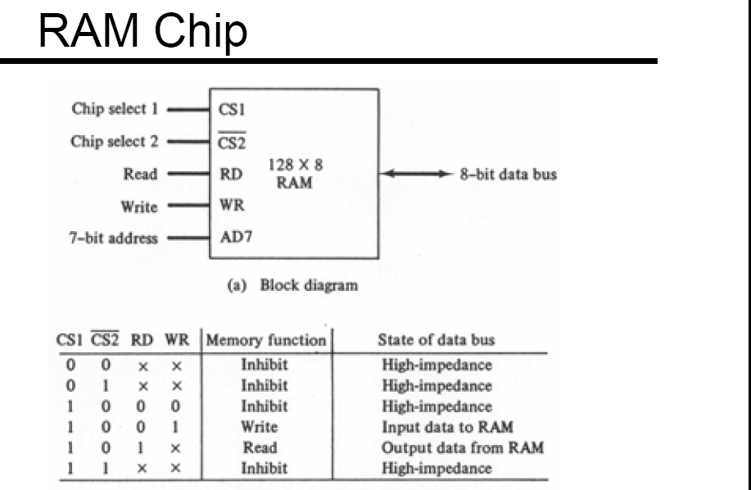

Slide 6
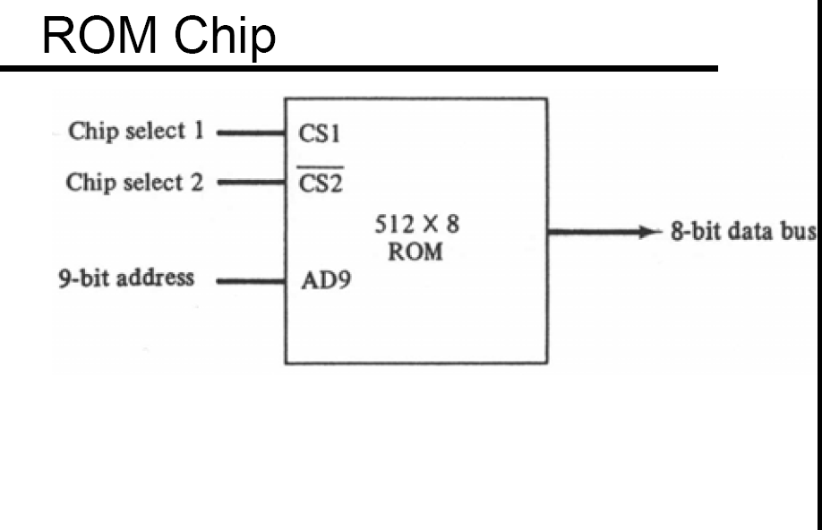

Slide 7
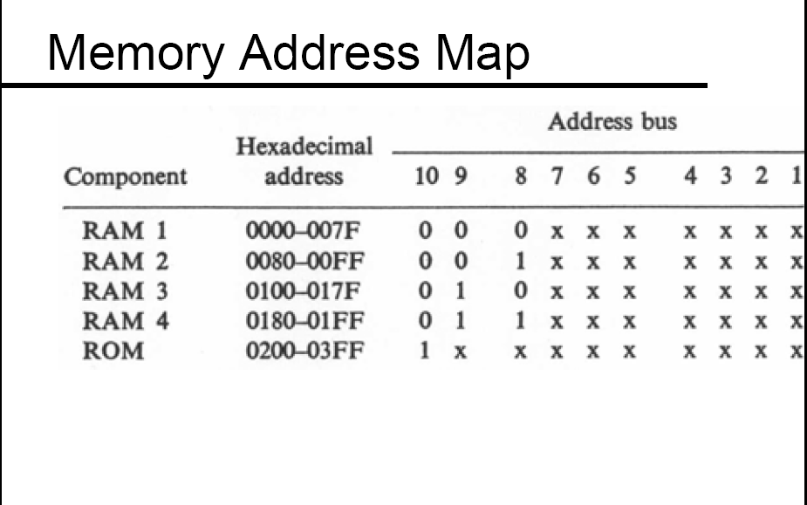
Address space assignment to each memory chip

Slide 8

Memory Connection to CPU
Address bus
CPU
16-11
10
9
8
7-1
RD
WR
Data bus
Decoder
RAM and ROM chips are connected to a CPU through the data and address buses
The low-order lines in the address bus select the byte within the chips and other lines in the address bus select a particular chip through its chip select inputs
3
2
1
0
CS1
CS2
128 x 8
Data
RD
RAM 1
WR
AD7
CS1
CS2
128 x 8
Data
RD
RAM 2
WR
AD7
CS1
CS2
128 x 8
Data
RD
RAM 3
WR
AD7
CS1
CS2
128 x 8
RD
RAM 4
Data
WR
AD7
CS1
1- 7
CS2
512 x 8
8
ROM
Data
9
AD9

Slide 9
Memory Design
Available Memory chip Size M_{N, W}: N × W
Required memory size: N’ × W’, Where N’≥ N and W’≥ W
Required number of M_{N, W} chips: p × q, Where p = N’ / N and q = W’/ W

Slide 10
Memory design
There are 3 types of organizations of N’ × W’ that can be formed using N × W
N’ = N and W’ > W => increasing the word size of the chip
N’ > N and W’ = W => increasing the number of words in the memory
N’ > N and W’ > W => increasing both the number of words and number of bits in each word.

Slide 11
There are different types of organization of N¹ x W¹ –memory using N x W –bit chips
How many 1024x 8 RAM chips are needed to provide a memory capacity of 2048 x 8?
Case 1:
If
N^{I} > N
&
W^{I} = W
N^{I}
Increase number of words by the factor of
p
=
N
How many 1024x 4 RAM chips are needed to provide a memory capacity of 1024 x 8?
Case 2:
If
N^{I} = N
&
W^{I} > W
W^{I}
Increase the word size of a Memory by a factor of
q
=
W
How many 1024x 4 RAM chips are needed to provide a memory capacity of 2048 x 8?
Case 3:
If
N^{I} > N
&
W^{I} > W
&
Increase number of words by the factor of p
Increase the word size of a Memory by a factor of q

Slide 12
Memory design – Increasing the word size
Problem - 1
Design 128 × 16 - bit RAM using 128 × 4 - bit RAM
Solution: p = 128 / 128 = 1; q = 16 / 4 = 4
Therefore, p × q = 1 × 4 = 4 memory chips of size 128 × 4 are required to construct 128 × 16 bit RAM
S.No
Memory
Type
N × W
N¹ × W¹
p
q
p * q
x
y
z
Total
1
RAM
128 × 4
128 × 16
1
4
4
7
0
0
7
x – number of address lines
y (p = 2^{y}) – to select one among the same type of memory
z – to select the type of memory

Slide 13
Memory Address Map
Component
Hexadecimal address
Address Bus
From
To
15
14
13
12
11
10
9
8
7
6
5
4
3
2
1
0
0000
007F
x
0
1
0
1
x
x
0
1
0
1
x
x
0
1
x
0
1
x
0
RAM 1.1
1
RAM 1.2
0000
007F
x
x
x
x
x
x
x
RAM 1.3
0000
007F
x
x
x
x
x
x
x
RAM 1.4
0000
007F
x
x
x
x
x
x
x
Substitute 0 in place of x to get ‘From’ address and 1 to get ‘To’ address

Slide 14
Memory design – Increasing the word size
Data Bus
16
4
4
4
4
Data (0-3)
Data (0-3)
Data (0-3)
Data (0-3)
Address (0-6)
Address (0-6)
Address (0-6)
Address (0-6)
128 × 4
RAM
128 × 4
RAM
128 × 4
RAM
128 × 4
RAM
Address
Bus
CS
R/W
CS
R/W
CS
R/W
CS
R/W
7
Chip Select
Read/write Control

Slide 15
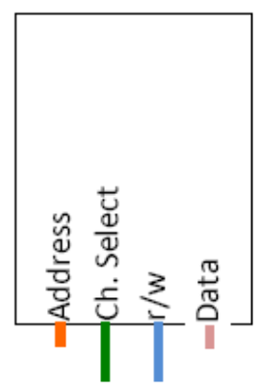
Memory Design
Data
r/w
 |  |  |  |  |  |  |  | 6 - 0
16
7
128 x 4
RAM
128 x 4
RAM
128 x 4
RAM
128 x 4
RAM
1
4
4
4
4

Slide 16
Memory Design – Increasing the number of words
Problem - 2
Design 1024 × 8 - bit RAM using 256 × 8 - bit RAM
Solution: p = 1024 / 256 = 4; q = 8 / 8 = 1
Therefore, p × q = 4 × 1 = 4 memory chips of size 256 × 8 are required to construct 1024 × 8 bit RAM
S.NO | Memory | N x W | N¹ x W¹ | P | q | p * q | x | y | z | Total
1 | RAM | 256 × 8 | 1024 × 8 | 4 | 1 | 4 | 8 | 2 | 0 | 10
2
3
4

Slide 17
Memory Address Map
Component
Hexadecimal address
Address Bus
From
To
15
14
13
12
11
10
9
8
7
6
5
4
3
2
1
0
0000
00FF
x
x
0
1
0
1
x
x
0
1
0
1
x
x
0
1
x
0
1
x
0
RAM 1
0
0
0
1
1
RAM 2
0100
01FF
0
1
x
x
x
x
x
x
x
x
RAM 3
0200
02FF
1
0
x
x
x
x
x
x
x
x
RAM 4
0300
03FF
1
1
x
x
x
x
x
x
x
x
Substitute 0 in place of x to get ‘From’ address and 1 to get ‘To’ address

Slide 18
Memory Design – Increasing the number of words
8
Data
Bus
Address Bus
256 × 8
RAM
Address Bus
A₀ – A₇
8
8
CS
R / W
Address Bus
256 × 8
RAM
Data
Bus
0
1
2
3
8
8
A₈
CS
R / W
2 × 4
decoder
A₉
Address Bus
256 × 8
RAM
Data
Bus
8
8
CS
R / W
Data
Bus
Address Bus
256 × 8
RAM
8
8
CS
R / W
8
R / W
Data
Bus

Slide 19
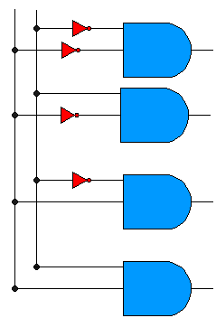
Design with gates
8
Data
Bus
Address Bus
256 × 8
RAM
Address Bus
A₀ – A₇
8
8
A₉
A₈
CS
R / W
Address Bus
256 × 8
RAM
Data
Bus
8
8
CS
R / W
Address Bus
256 × 8
RAM
Data
Bus
8
8
CS
R / W
Data
Bus
Address Bus
256 × 8
RAM
8
8
CS
R / W
8
R / W
Data
Bus

Slide 20
 |  |  |  |  |  | 9 | 8 | 7 - 0
256 × 8
RAM 1
Data
r/w
8
8
256 × 8
RAM 2
8
2 × 4
Decoder
3 2 1 0
256 × 8
RAM 3
8
256 × 8
RAM 4
8

Slide 21
Memory Design
Problem - 3
Design 256 × 16 – bit RAM using 128 × 8 – bit RAM chips
S.NO | Memory | N x W | N¹ x W¹ | P | q | p * q | x | y | z | Total
1 | RAM | 128 × 8 | 256 × 16 | 2 | 2 | 4 | 7 | 1 | 0 | 8
2
3
4

Slide 22
Memory Address Map
Component
Hexadecimal address
Address Bus
From
To
15
14
13
12
11
10
9
8
7
6
5
4
3
2
1
0
RAM 1.1
0000
007F
0
x
x
x
x
x
x
x
RAM 1.2
0000
007F
0
x
x
x
x
x
x
x
RAM 2.1
0080
00FF
1
x
x
x
x
x
x
x
RAM 2.2
0080
00FF
1
x
x
x
x
x
x
x

Slide 23
 |  |  |  |  |  |  | 7 | 6 - 0
Data
r/w
Address Bus
128 × 8
RAM 1.1
128 × 8
RAM 1.2
1 × 2
Decoder
1 0
16
8
8
128 × 8
RAM 2.1
128 × 8
RAM 2.2
16
8
8

Slide 24
Memory Design
Problem - 4
Design 256 × 16 – bit RAM using 256 × 8 – bit RAM chips and 256 × 8 – bit ROM using 128 × 8 – bit ROM chips.
S.NO | Memory | N x W | N¹ x W¹ | P | q | p * q | x | y | z | Total
1 | RAM | 256 × 8 | 256 × 16 | 1 | 2 | 2 | 8 | 0 | 1 | 9
2 | Rom | 128 × 8 | 256 × 8 | 2 | 1 | 2 | 7 | 1 | 1 | 9
3
4

Slide 25
Memory Address Map
Component
Hexadecimal address
Address Bus
From
To
15
14
13
12
11
10
9
8
7
6
5
4
3
2
1
0
RAM 1.1
0000
00FF
0
x
x
x
x
x
x
x
x
RAM 1.2
0000
00FF
0
x
x
x
x
x
x
x
x
ROM 1
0100
017F
1
0
x
x
x
x
x
x
x
ROM 2
0180
01FF
1
1
x
x
x
x
x
x
x

Slide 26
Address Bus
 |  |  |  |  |  | 8 | 7 | 6 - 0
128 × 8
ROM 1
Data
r/w
1 × 2
Decoder
1 × 2
Decoder
8
1 0
1 0
128 × 8
ROM 2
●
8
256 × 8
RAM 1.1
256 × 8
RAM 1.2
16
8
8

Slide 27
Memory design
Problem – 5
A computer employs RAM chips of 128 x 8 and ROM chips of 512 x 8. The computer system needs 256 bytes of RAM, 1024 x 16 of ROM, and two interface units with 256 registers each. A memory mapped I/O configuration is used. The two higher -order bits of the address bus are assigned 00 for RAM, 01 for ROM, and 10 for interface registers.
a. Compute total number of decoders are needed for the above system?
b. Design a memory-address map for the above system
c. Show the chip layout for the above design

Slide 28
Requirements
S.NO | Memory | N x W | N¹ x W¹ | P | q | p * q | x | y | z | Total
1 | RAM | 128 × 8 | 256 × 8 | 2 | 1 | 2 | 7 | 1 | 2 | 10
2 | ROM | 512 × 8 | 1024 × 16 | 2 | 2 | 4 | 9 | 1 | 2 | 12
3 | Interface | 256 |  | 2 | 1 | 2 | 8 | 1 | 2 | 11
4
q is 1 always for interfaces.
Number of registers = 2^{x}
P = number of interfaces
Number of data lines = size of registers

Slide 29
Memory Address Map
Component | Hexadecimal Address |  | Address Bus
 | From | To | 15 - 12 | 11 | 10 | 9 | 8 | 7 | 6 | 5 | 4 | 3 | 2 | 1 | 0
RAM1 | 0000 | 007F |  | 0 | 0 | 0 |  |  | x | x | x | x | x | x | x
RAM2 | 0200 | 027F |  | 0 | 0 | 1 |  |  | x | x | x | x | x | x | x
ROM1.1 | 0400 | 05FF |  | 0 | 1 | 0 | x | x | x | x | x | x | x | x | x
ROM1.2 | 0400 | 05FF |  | 0 | 1 | 0 | x | x | x | x | x | x | x | x | x
ROM2.1 | 0600 | 07FF |  | 0 | 1 | 1 | x | x | x | x | x | x | x | x | x
ROM2.2 | 0600 | 07FF |  | 0 | 1 | 1 | x | x | x | x | x | x | x | x | x
Interface1 | 0800 | 08FF |  | 1 | 0 | 0 |  | x | x | x | x | x | x | x | x
Interface2 | 0A00 | 0AFF |  | 1 | 0 | 1 |  | x | x | x | x | x | x | x | x

Slide 30
Address Bus
 |  |  | 11 | 10 | 9 | 8 | 7 | 6 - 0
128 × 8
RAM 1
Data
r/w
128 × 8
RAM 2
0
1
2
3
4
5
512 × 8
ROM 1.1
512 × 8
ROM 1.2
3 × 8
Decoder
512 × 8
ROM 2.1
512 × 8
ROM 2.2
Ch.
Select
Interface 1
Address
r/w
Data
Ch.
Select
Interface 2
Address
r/w
Data

Slide 31
Example 1
A computer employs RAM chips of 1024 x 8 and ROM chips of 2048 x 4. The computer system needs 2K x 16 of RAM, and 2K x 16 ROM and an interface unit with 256 registers each. A memory-mapped I/O configuration is used. The two higher -order bits of the address bus are assigned 00 for RAM, 01 for ROM, and 10 for interface..
a). How many RAM and ROM chips are needed?
b). How many lines of the address bus must be used to access total memory? How many of these lines will be common to all chips?
c). How many lines must be decoded for chip select? Specify the size of the decoder
d). Draw a memory-address map for the system.
e). Draw a memory-address map for the system and Give the address range in hexadecimal for RAM, ROM
f). Develop a chip layout for the above said specifications

Slide 32
References
Text Book(s)
M. M. Mano, Computer System Architecture, Prentice-Hall,2004
J. P. Hayes, Computer system architecture, McGraw Hill,2000

